Slide 1

Customer Churn Prediction Project

Slide 2
Introduction
Understanding customer churn is critical for enhancing customer retention strategies. This project aims to analyze factors influencing churn and propose actionable solutions.
The Customer Churn Prediction project aims to predict customer churn for a telecom company using historical customer data. The objective is to identify customers who are likely to leave, enabling targeted retention strategies.
- Effective customer churn prediction helps the business to hold on to one of its most important assets – its customers. Since keeping existing customers is easier and more economical than winning new ones, businesses do everything they can to minimize customer churn.

Slide 3
Main Problem and Solution
The primary challenge is predicting which customers are at risk of churning. The solution involves building a machine learning model to predict churn based on key factors.
a. Data problems:
- Incorrect Data Type in Total charges and blank space values
- Handling categorical variables and imbalanced classes.
b. Solution:
- Data cleaning and resampling were done to ensure model accuracy.

Slide 4
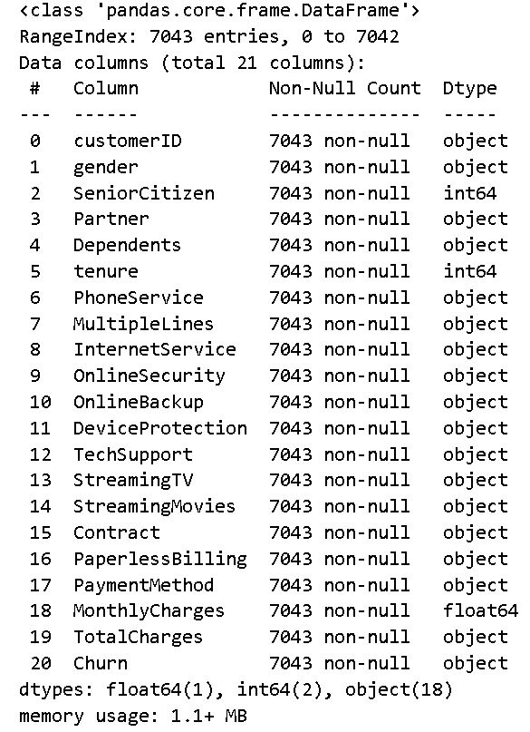
Data overview
Data with (7043) record & (21) features (columns).
Data with (1) float column & (2) int & (18) string columns.
No missing records - (TotalCharges) feature is string it must be float!

Slide 5
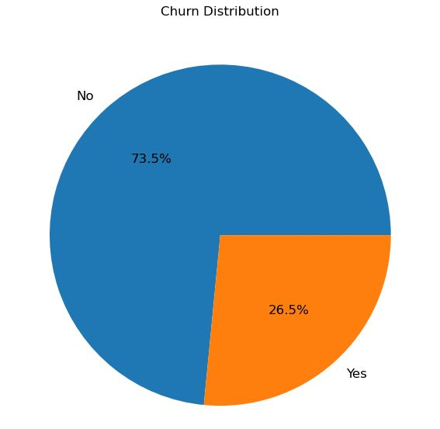
Data Cleaning
1. Checked for Missing , Duplicates and Outliers
2. removed the customerID column
3. Fixed ‘TotalCharges’ column having wrong data type and blank space values to zeroes
4. we can see that we have an imbalanced target

Slide 6
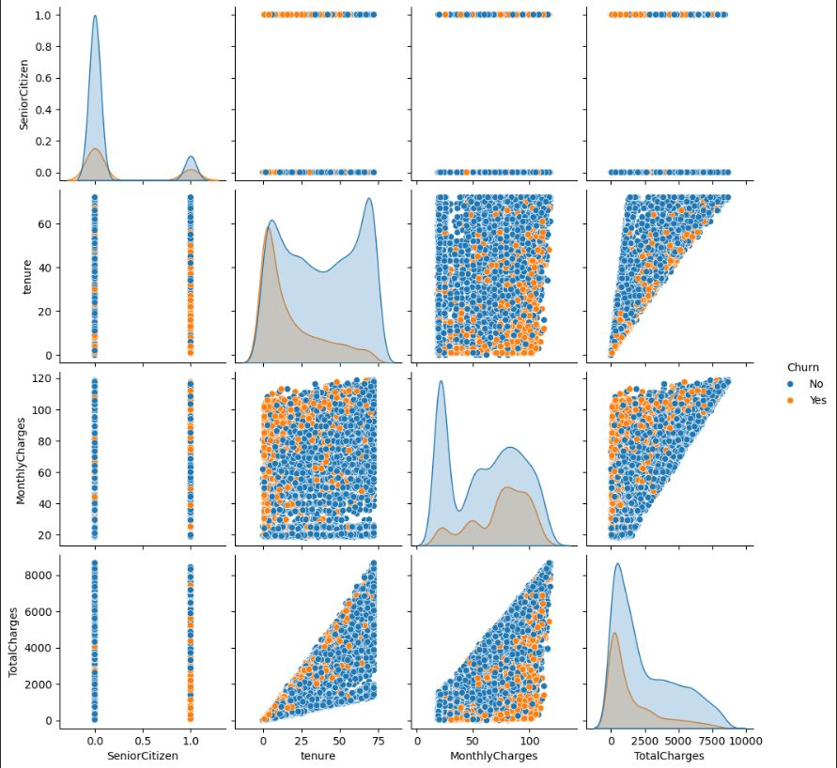
Exploratory Data Analysis (EDA)
1. scanning through the initial analysis we can see that there are no outliers
2. we can also observe that we can’t visually find a clear feature separator for the data
3. analyzing the scatter plot we can see that the data is NOT Linearly separable and that it is interweaved.

Slide 7
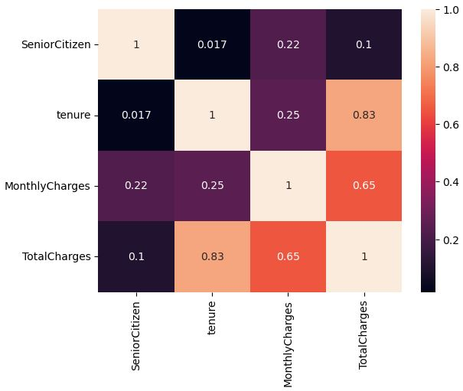
Exploratory Data Analysis (EDA)
4. analyzing the correlation matrix we can that we have a correlation between monthly charges and total charges at 0.65
5. we have a strong correlation between tenure and total charges at 0.83
6. we have slight correlation between tenure and monthly charges at 0.25

Slide 8
Data Preprocessing
1.converted target ‘Churn’ into 0 and 1
2.Encoded categorical variables using One Hot Encoder.
3.Balanced the dataset using SMOTETomek to address class imbalance.
4.Scaled numerical features using StandardScaler.

Slide 9
Machine Learning Techniques
1. Applied the following models for initial testing
LogisticRegression,KNeighborsClassifier,GaussianNB,SVC,DecisionTreeClassifier,RandomForestClassifier,XGBClassifier,LGBMClassifier,CatBoostClassifier and MLPClassifier
2. Utilized cross-validation for model evaluation.
3. Tuned hyperparameters using GridSearchCV.
4. Focused on Recall since it is the most important performance parameter here because we want to detect the actual churners in order to help the business retain them better

Slide 10
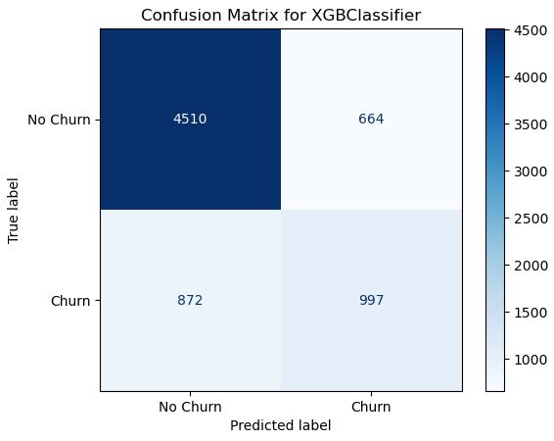
Why Recall ?
As we can see from the graph that the False Negatives are 872 and this is the main value we want to minimize and focus on since having less false negatives means the model can accurately predict customers who truly churn and therefore prevent the business from loosing those customers.

Slide 11
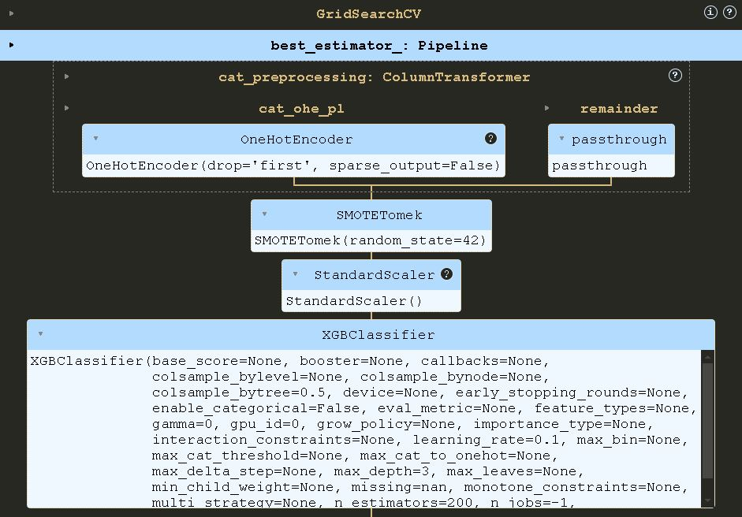
Final Model and results
After tuning some of the models - LogisticRegression
- SVC
- RandomForestClassifier
- XGBClassifier
We have XGBClassifier with the highest score at 80%.

Slide 12

Key Business insights

Slide 13
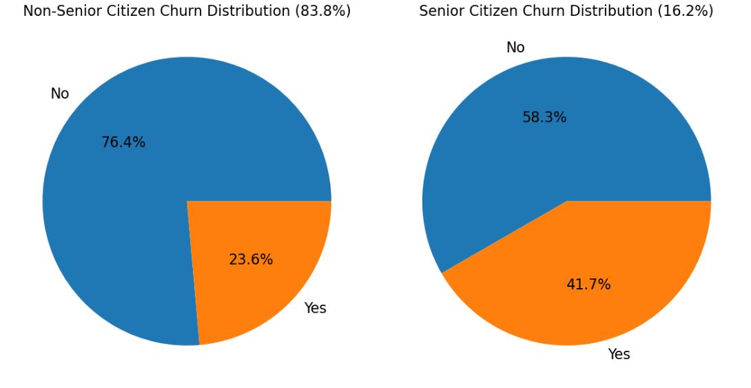
Senior citizine
Even though Senior Citizens represent only 16% of our data but almost 41% of them walk away
senior citizens who churned were paying 80.7 (24.7%) more than avg Monthly Charges 64.7 but close to their peers which was 79.1
senior citizens stay for avg of 21 months compared to the 42 months of their peers and less than the data average which is 32 months

Slide 14
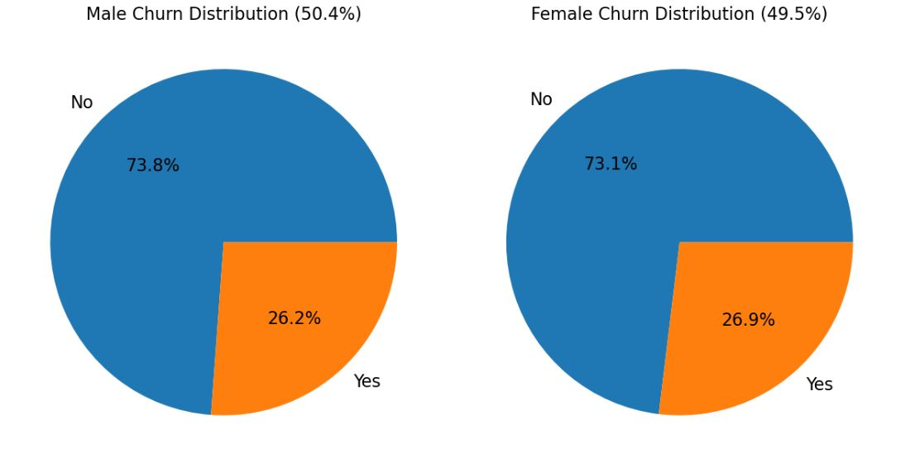
gender
Gender does not significantly affect churn rate.
As well as having almost 50% representation in the data between males and females
Having avg monthly charges of 65 for females and 64 for males
Average tenure of 32 months for both

Slide 15
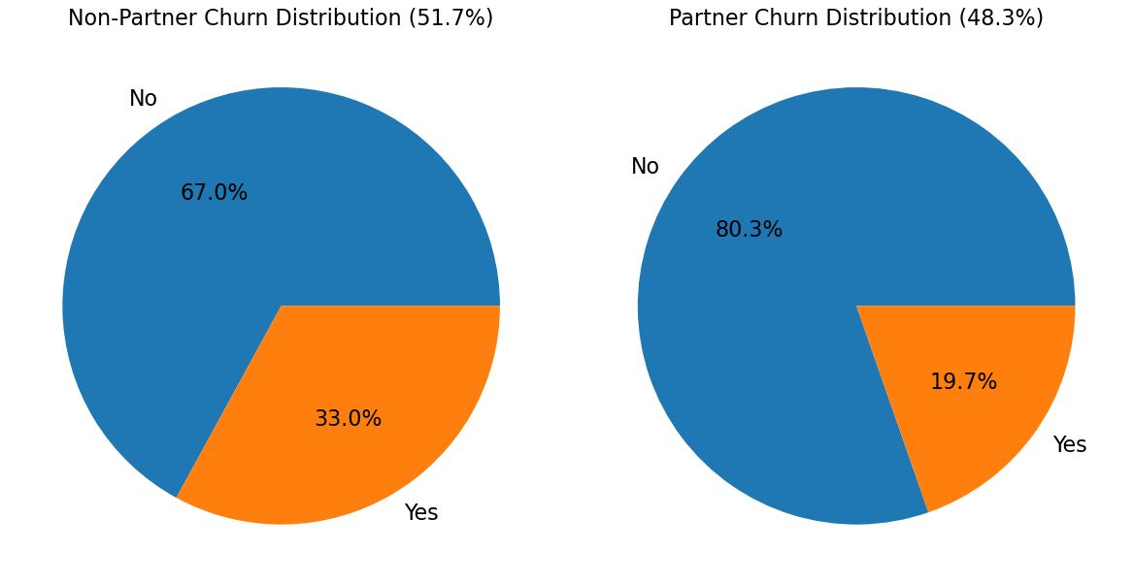
Customers with partners
Customers with no partners who churned pay an average monthly fee of 71.4 and stay for 13 months compared to their peers who stayed with the business that paid 57.27 avg monthly charges and stayed for 28.36 months

Slide 16
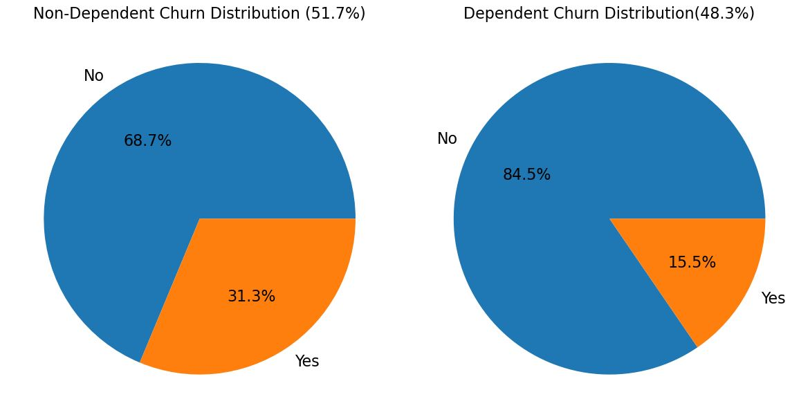
Customers with Dependents
Customers with no dependants who churned pay an average monthly fee of 74.7 and stay for 17 months compared to their peers who stayed with the business that paid 63.46 avg monthly charges and stayed for 35.5 months

Slide 17
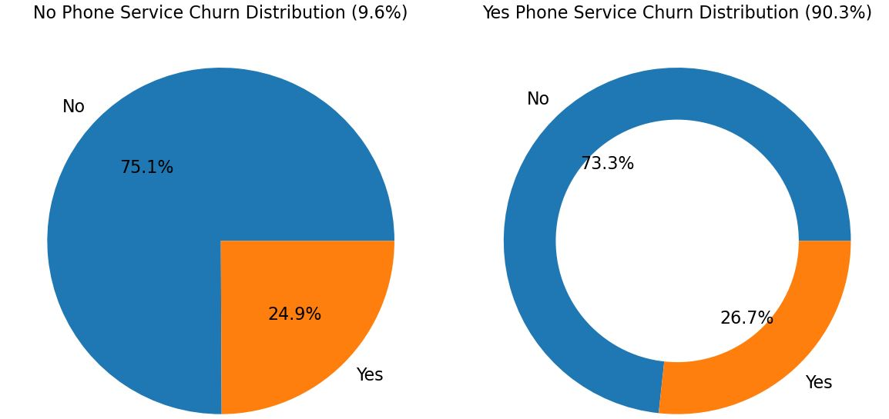
Customers with phone service
Customers with no phone service who churned paid 37.5 avg monthly fees and stayed around 15.8 months while the ones that didn’t churn paid 43.5 on avg and stayed for 37 months.
Customers with Phone Service who churned who paid 78 monthly fees and staying for 18 months while the ones who didn’t churn paid 63 on avg and stayed 37.6 months.

Slide 18
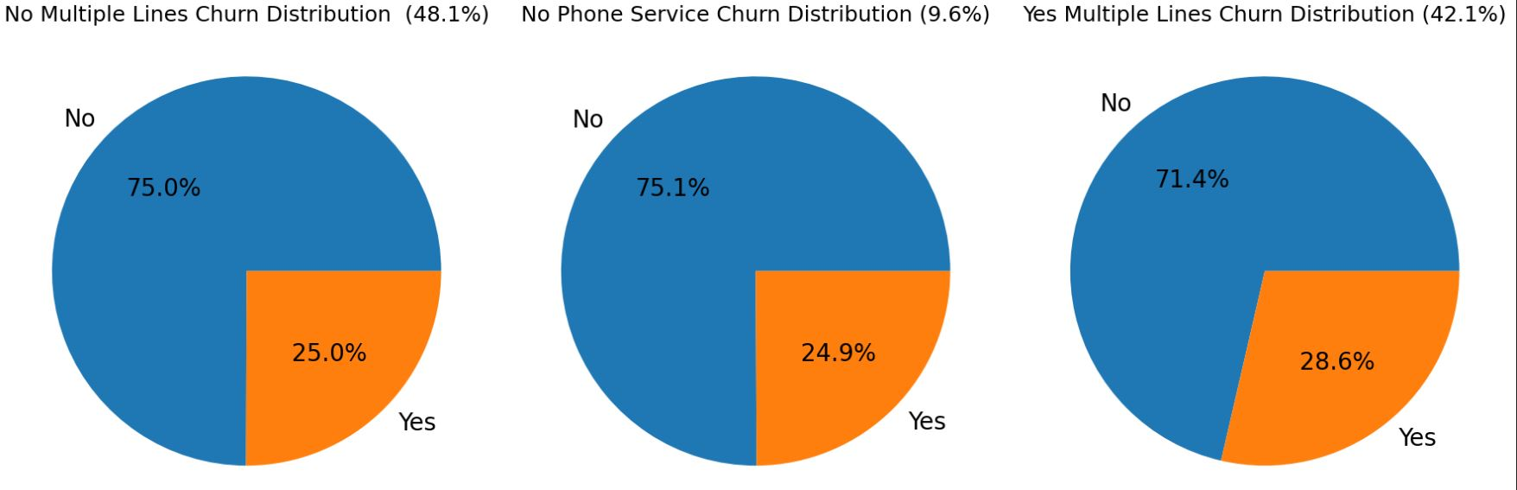
Customers with multiple lines
Customers with multiple lines who churned pay an average monthly fee of 89 and stay for 25 months compared to their peers who stayed with the business that paid 79 avg monthly charges and stayed for 48 months

Slide 19
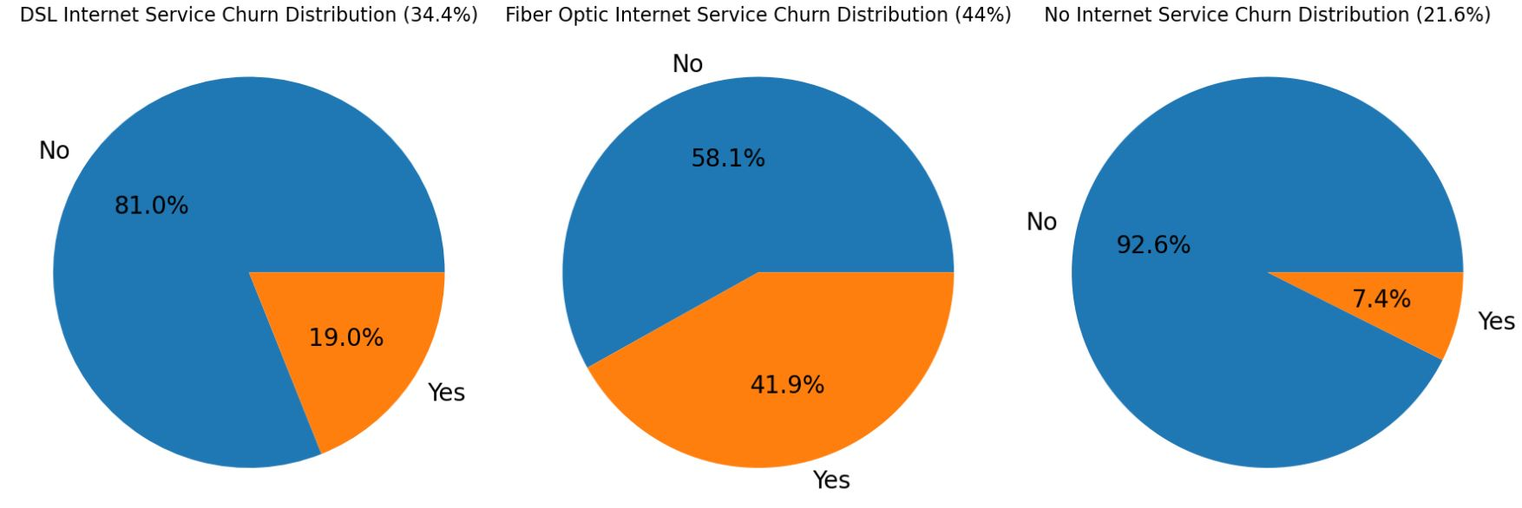
Customers with internet service
Customers with Fiper optic internet service who churned pay an average monthly fee of 88 and stay for 20 months compared to their peers who stayed with the business that paid 94 avg monthly charges and stayed for 42 months

Slide 20
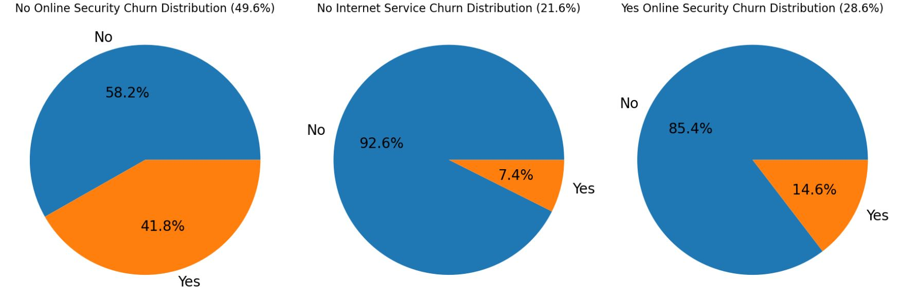
Customers with OnlineSecurity
Customers with no online security who churned pay an average monthly fee of 77 and stay for 16.4 months compared to their peers who stayed with the business that paid 74.6 avg monthly charges and stayed for 32.5 months

Slide 21
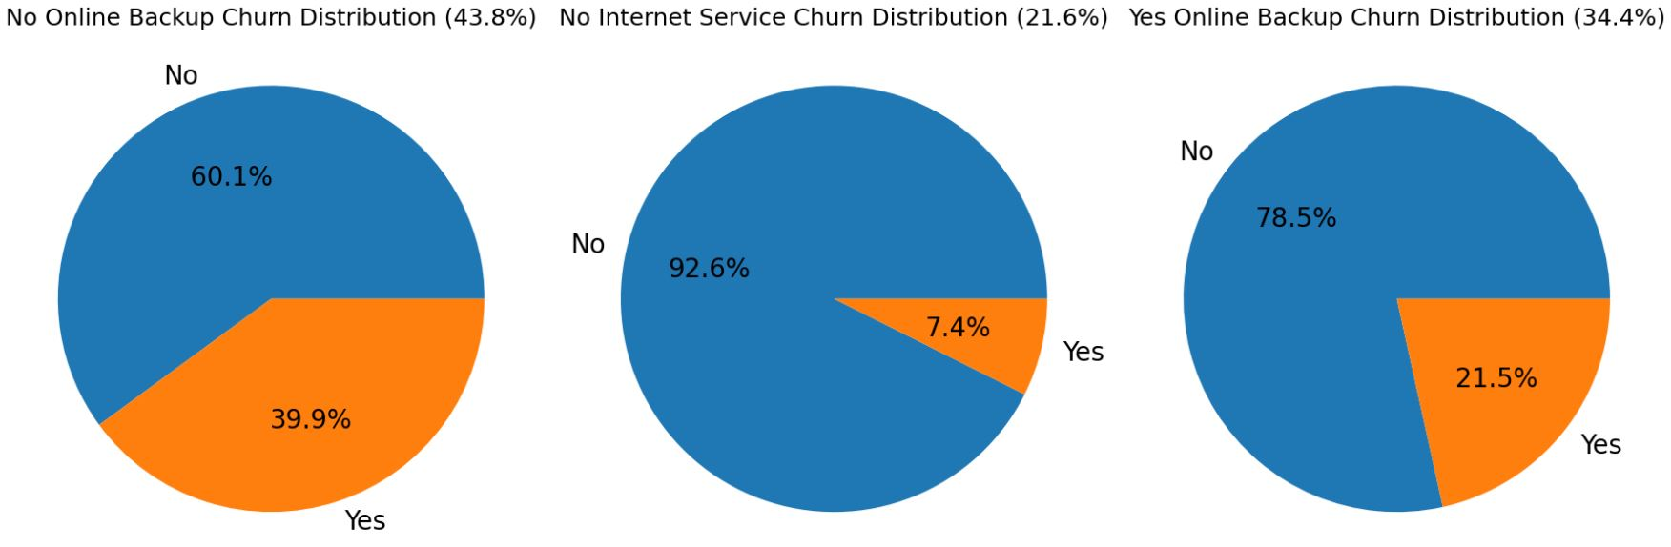
Customers with OnlineBackup
Customers with no Online Backup who churned pay an average monthly fee of 74.5 and stay for 13.7 months compared to their peers who stayed with the business that paid 70 avg monthly charges and stayed for 30 months

Slide 22
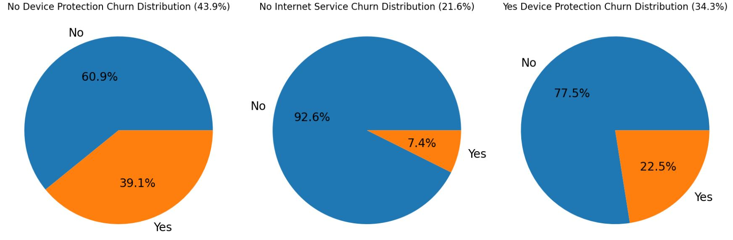
Customers with DeviceProtection
Customers with no DeviceProtection who churned pay an average monthly fee of 73 and stay for 14 months compared to their peers who stayed with the business that paid 69 avg monthly charges and stayed for 29.85 months

Slide 23
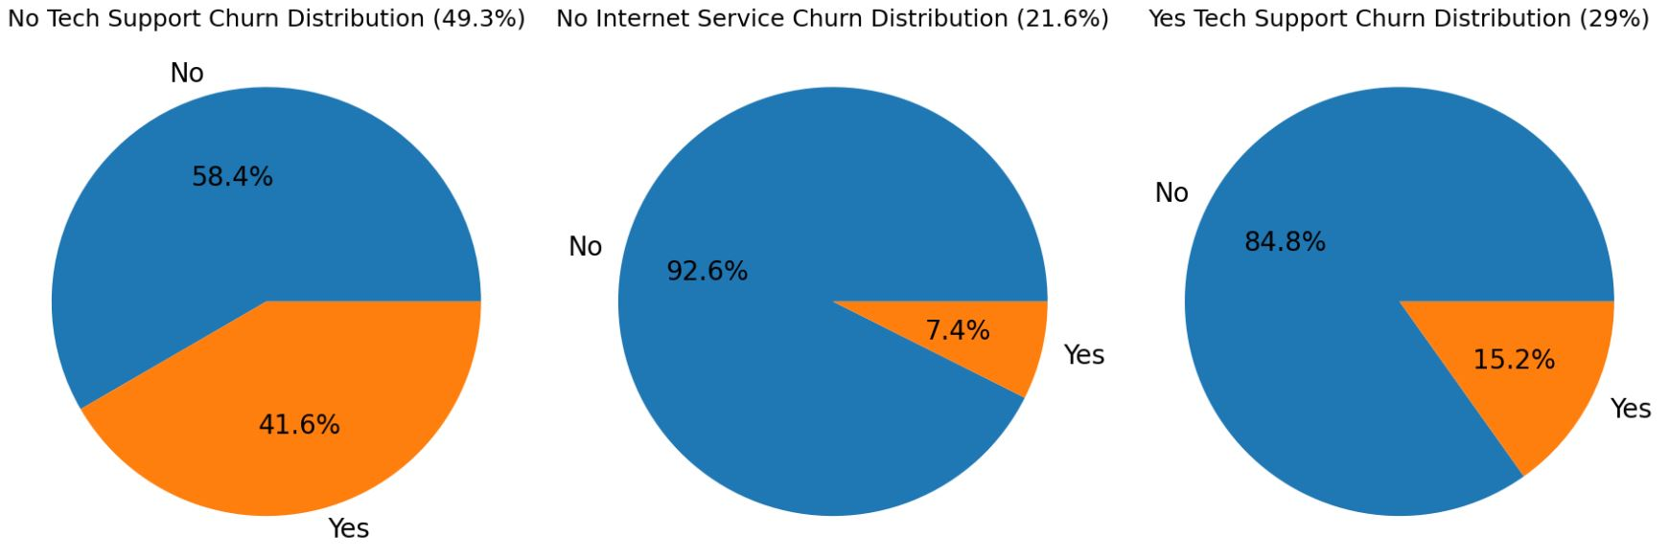
Customers with TechSupport
Customers with no Tech support who churned pay an average monthly fee of 76.5 and stay for 16 months compared to their peers who stayed with the business that paid 73 avg monthly charges and stayed for 32 months

Slide 24
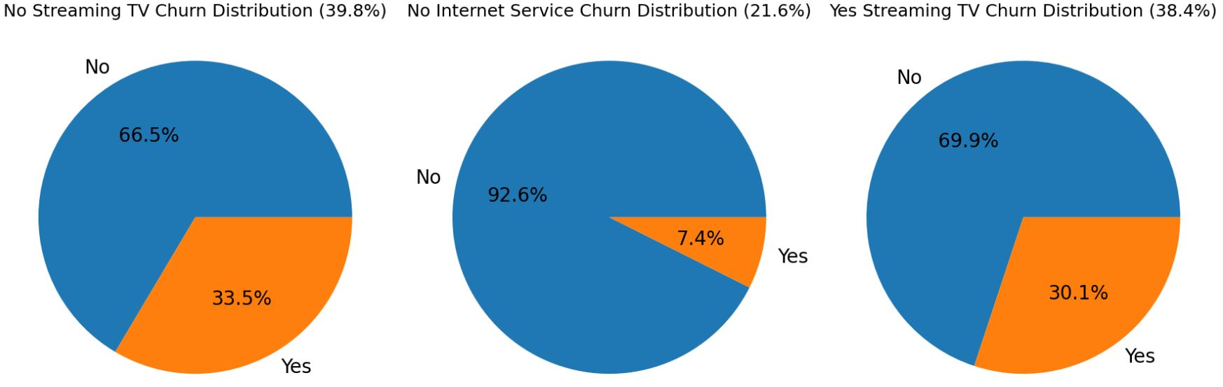
Customers with StreamingTV
Customers with no Streaming TV service who churned pay an average monthly fee of 67 and stay for 12 months compared to their peers who stayed with the business that paid 64 avg monthly charges and stayed for 31 months
Customers with Streaming TV service who churned pay an average monthly fee of 90 and stay for 25 months compared to their peers who stayed with the business that paid 88 avg monthly charges and stayed for 47.6 months

Slide 25
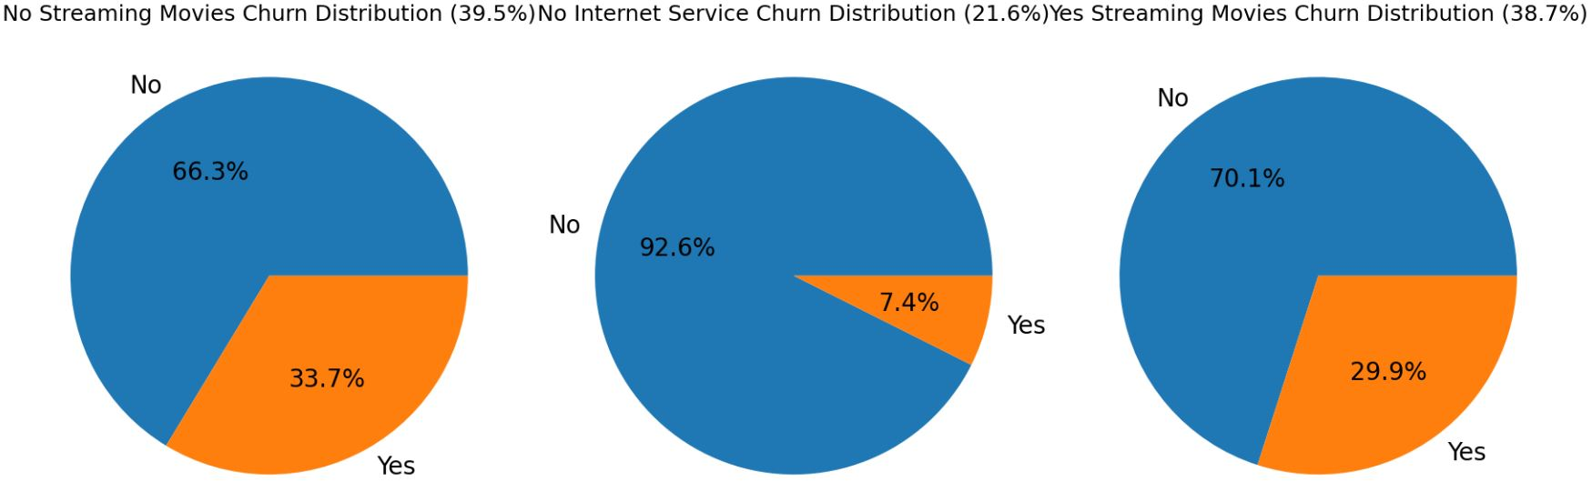
Customers with Streaming Movies
Customers with no Streaming movies service who churned pay an average monthly fee of 67 and stay for 12 months compared to their peers who stayed with the business that paid 64 avg monthly charges and stayed for 31 months

Slide 26
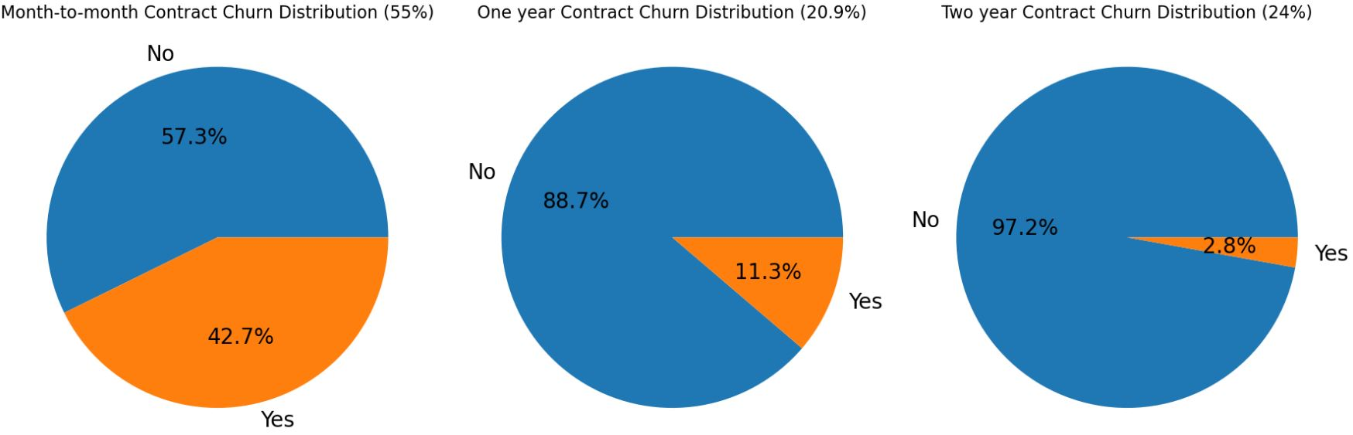
Customers with contract
Customers with month-to-month contract who churned pay an average monthly fee of 73 and stay for 14 months compared to their peers who stayed with the business that paid 61 avg monthly charges and stayed for 21 months

Slide 27
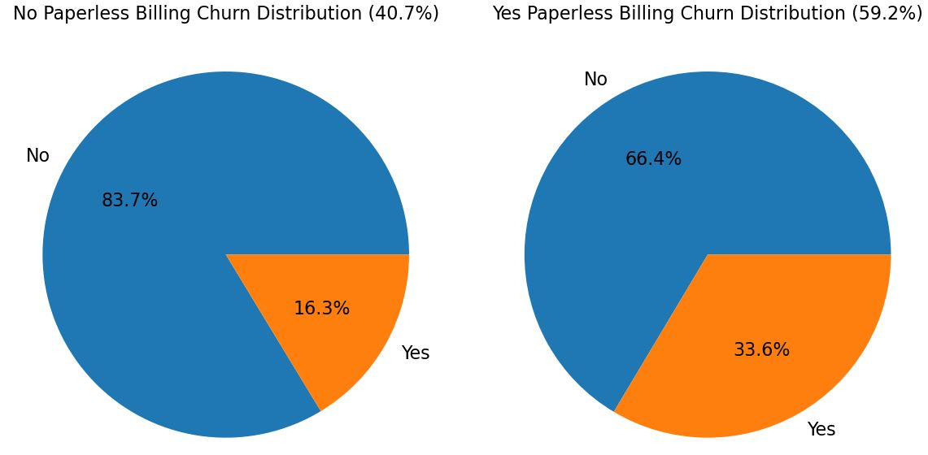
Customers with PaperlessBilling
Customers who prefer paperless billing who churned pay an average monthly fee of 78 and stay for 18 months compared to their peers who stayed with the business that paid 71 avg monthly charges and stayed for 39 months

Slide 28
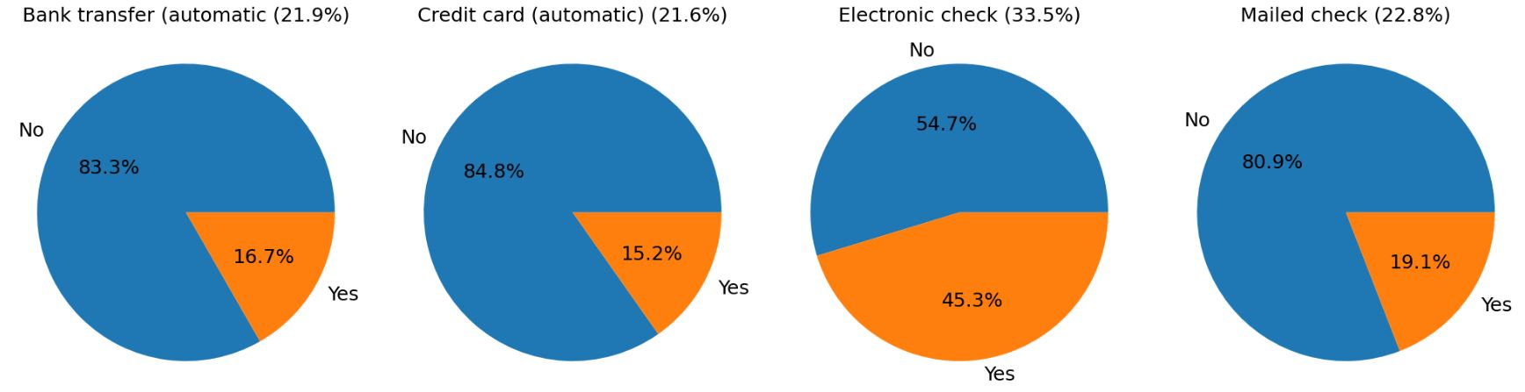
Customers with PaymentMethod
Customers who chose Electronic check who churned pay an average monthly fee of 78.7 and stay for 16 months compared to their peers who stayed with the business that paid 74 avg monthly charges and stayed for 32 months

Slide 29
Customers with partners
Customers with no partners who churned pay an average monthly fee of 71.4 and stay for 13 months compared to their peers who stayed with the business that paid 57.27 avg monthly charges and stayed for 28.36 months

Slide 30
Customers with partners
Customers with no partners who churned pay an average monthly fee of 71.4 and stay for 13 months compared to their peers who stayed with the business that paid 57.27 avg monthly charges and stayed for 28.36 months

Slide 31
Customers with partners
Customers with no partners who churned pay an average monthly fee of 71.4 and stay for 13 months compared to their peers who stayed with the business that paid 57.27 avg monthly charges and stayed for 28.36 months

Slide 32

Conclusion and Recommendations
1. Address churn by offering incentives for long-term contracts.
2. Focus on improving services for high-churn demographics.
3. Monitor and adapt monthly charges for each demopraphic as it seems to be a pattern in the data that most customers who churn are paying more monthly fees on average.

Slide 33

Deployment on Streamlit
The churn prediction model was deployed as a web app using Streamlit:
- Users can input customer details and get predictions about churn probability.
- The app provides an interactive interface for business users to make data-driven decisions.

Slide 34

Conclusion
The customer churn prediction model offers valuable insights to help the business retain customers.
Further improvements can be made by incorporating additional features or using more advanced models.

Slide 35

Q&A
Questions:
Feel free to ask any questions regarding the analysis and findings.
Contact Information:
m.mabrouk.data@gmail.com

